Slide 1

DESIGN AND SIMULATION OF LOCAL AREA NETWORK USING CISCO PACKET TRACER
TEAM MEMBERS:
ABANOUB GOERGE
MAI MAHMOUD
NOUR BAHAA
IBRAHIM FAWZY
SUPERVISED BY: DOCTOR ISLAM THARWAT
ENG. AHMED HAZEM

Slide 2
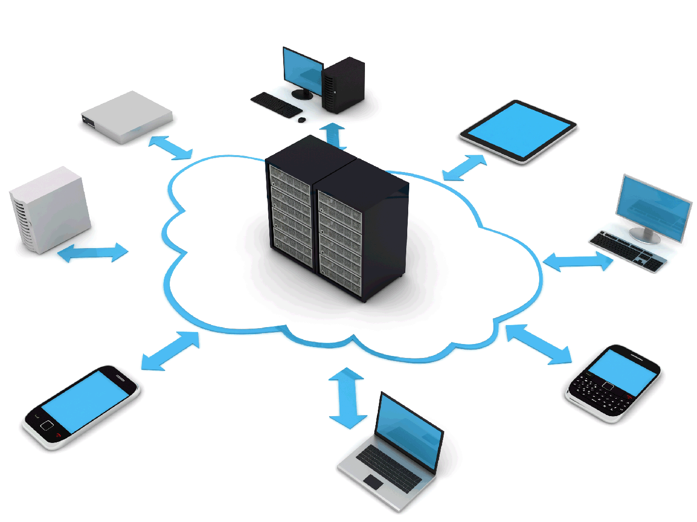
What Is a LAN?
LAN : is a group of computers and devices that share a communications line or wireless link to a server within the same geographical area.
LAN is a (Local Area Network ).
Computers within a limited area such as a residence, school, laboratory, university campus or office building.

Slide 3
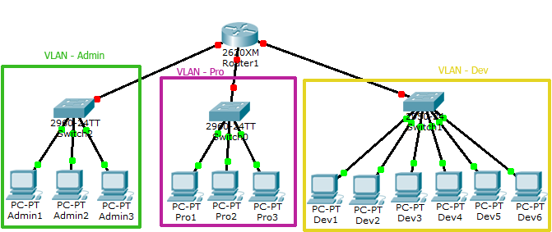
What Is a VLAN?
VLAN : is a subnetwork which can group together collections of devices on separate physical local area networks (LANs).
VLAN is a (virtual LAN).
VLANs are also important because they can help improve the overall performance of a network by grouping together devices that communicate most frequently.
VLANs also provide security on larger networks by allowing a higher degree of control over which devices have access to each other.

Slide 4
SO Let us talk about our Project !!

Slide 5
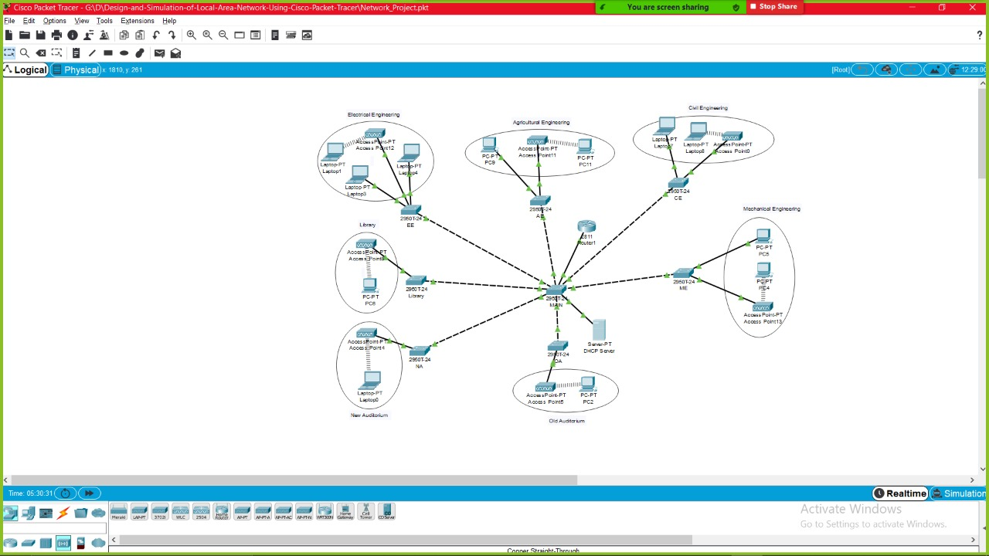
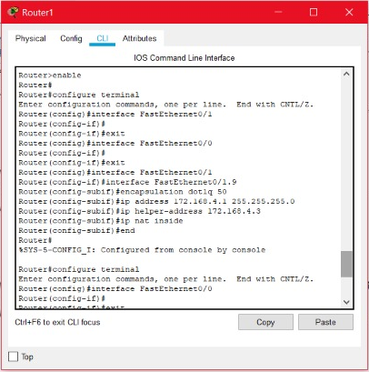
Topology

Slide 6
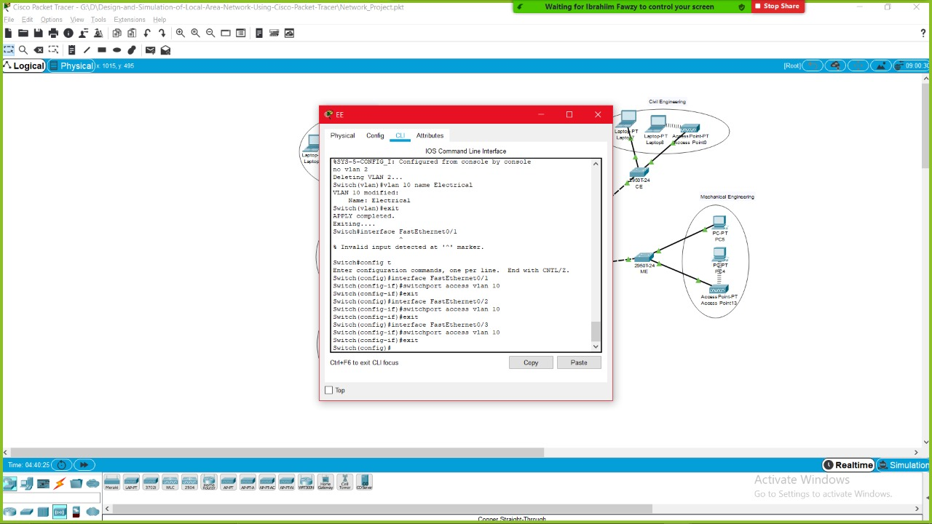
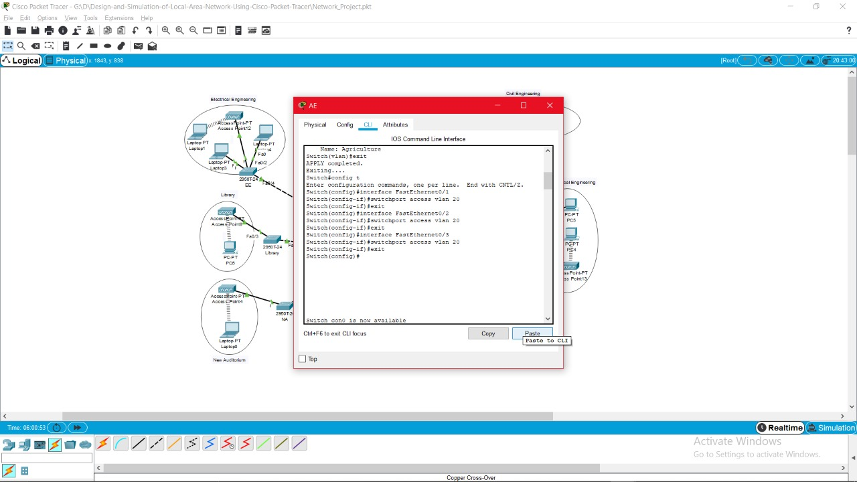
VLANs connections
Electrical
Agriculture

Slide 7
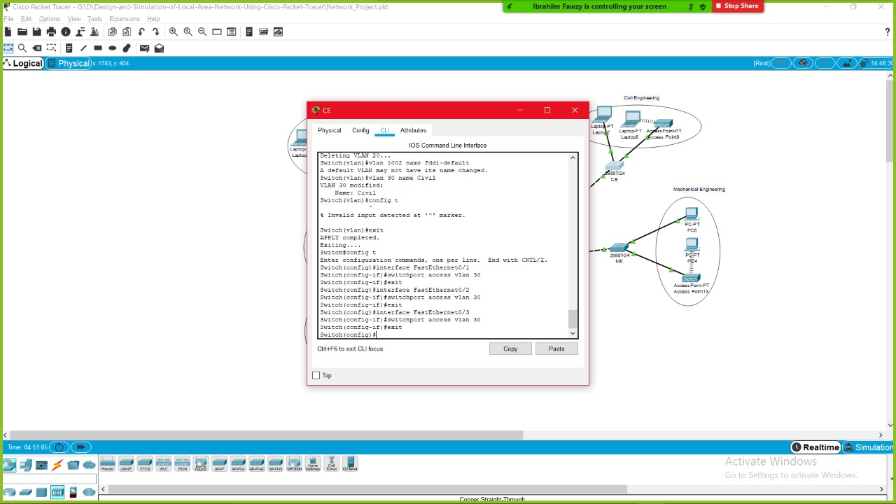

VLANs connections
Civil
Mechanical

Slide 8
VLANs connections
Network
Old

Slide 9
VLANs connections
New
Library

Slide 10
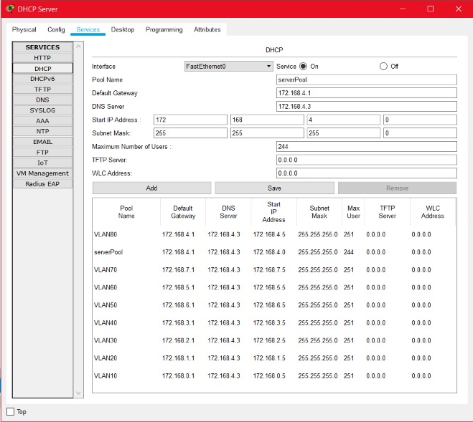
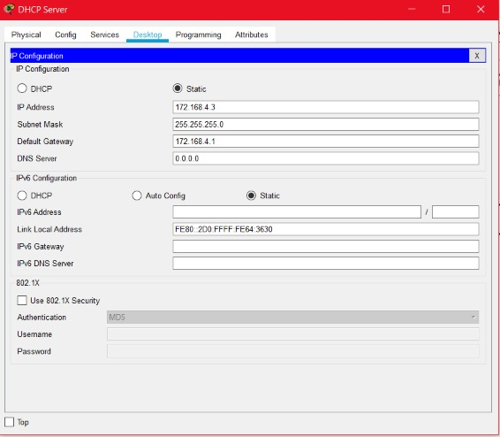
DHCP

Slide 11
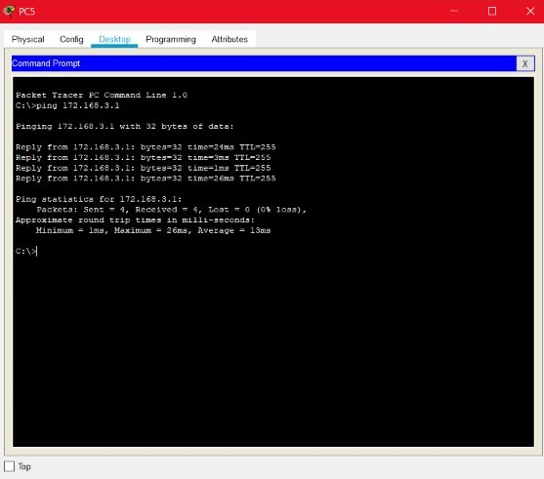
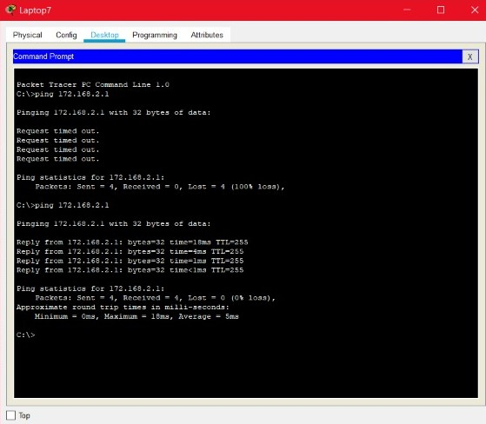
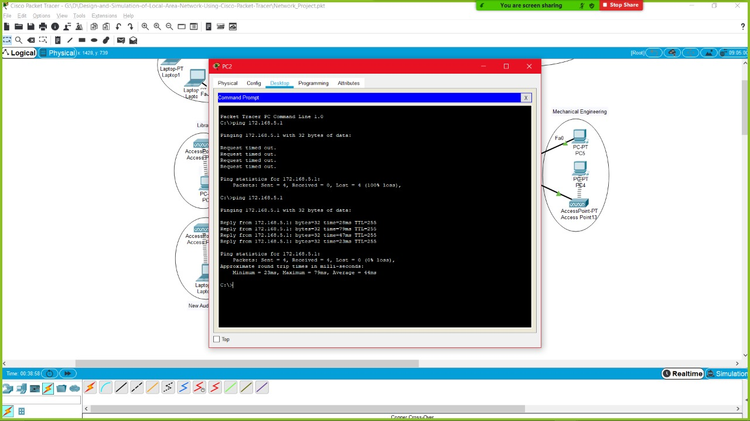
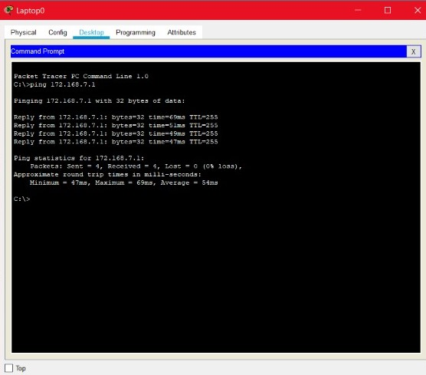
PING Results

Slide 12
GITHUB
GitHub - BonyGeorge/Design-and-Simulation-of-Local-Area-Network-Using-Cisco-Packet-Tracer

